Slide 1
Foundations Training

Slide 2
Recipient Rights
5

Slide 3
Goals
Identify
Identify mental health code protected rights with an emphasis on abuse/neglect definitions and reporting requirements.
Support
Support individuals to exercise their rights.
Perform
Perform job duties with dignity and respect for the person served.
Demonstrate
Demonstrate how to fill out and submit documented forms
Know
Know when and how to report rights violations including abuse and neglect to the appropriate authorities.
5

Slide 4
Civil Rights
Religious expression
Freedom of speech
Discrimination protection
Right to vote
Education
Privacy
Competence
5
Notes:
Everyone has civil rights afforded to us by the US Constitution. Recipients have additional rights afforded to them by the Mental Health Code.

Slide 5
The Mental Health Code
Communication
Property
Money
Freedom of movement
Confidentiality
Consent
Dignity and Respect
Legal
5

Slide 6
Confidentiality & Mental Health Code
Law requires confidentiality
Record maintained with disclosed information (what, to whom, why)
Limited information can be provided to legal and medical personnel who providing services to recipient without release.
5

Slide 7
Examples of Violating Confidentiality and Privacy of a Recipient
Talking
Talking about client outside of work
Giving
Giving information over the phone to those who say they are relatives
Taking
Taking pictures or video of client without written consent
Listening
Listening in on client’s phone conversations
Discussing
Discussing information with another mental health worker who is not authorized to have that information
Referring
Referring to the client by name in front of another client, or on an incident report

Slide 8
Release of Information
Information can only be released with Informed Consent:
Not pressured
Understands what agreeing to release
Understands risks, benefits and consequences
NOTE: A person who has a guardian is not legally capable of giving informed consent.
6

Slide 9
Dignity and Respect
Dignity
be treated with esteem, honor, politeness, or honesty
to be treated the way you would want to be treated.
Respect
be treated with esteem, concern & or appreciation
protect privacy
be sensitive to cultural differences
to allow the individual to make choices.
6

Slide 10
Abuse & Neglect Read Abuse & Neglect on Pages 6-7 in your Participant Guide
6

Slide 11
Reporting Abuse and Neglect
Act quickly.
Protecting the recipient is your primary responsibility: report abuse or neglect
All violations must be verbally reported immediately with a written report within 24 hours.
7

Slide 12
Whistleblowers Protection Act
Protects employees who report rights violations.
Illegal to discharge, threaten or discriminate against employees on compensation, terms, conditions, locations / privileges
7

Slide 13
Bullard-Plawecki Employee Right to Know Act
Notifies employee when disciplinary reports, letter of reprimands, disciplinary actions will be divulged.
7

Slide 14
Incident Reports
Recipient Injury
Any medically-related occurrence, such as a seizure
Environmental emergencies
Problem behaviors not in the treatment plan
Suspected abuse or neglect
Inappropriate sexual acts
Medication errors or refusals
Suspected criminal offenses involving recipients
Involvement of other agencies (police, fire, ems)
Recipient Death
8

Slide 15
Office of Recipient Rights for the Community Mental Health for Central Michigan (CMHCM) and Bay Arenac Behavioral Health (BABH)
8
Notes:
Role: Prevention, Monitoring, Education, Complaint Resolution. The advisors can be reached directly by calling the CMHCM main phone number and asking to speak with them.

Slide 16
Corporate Compliance, Ethics, & Deficit Reduction Act
8

Slide 17
CODE OF PROFESSIONAL ETHICS Please Read Appendix B in your Participant Guide.
8

Slide 18
False Claims Act
8

Slide 19
Fraud Prosecuted
Diagnosis, Medicine, Treatment
Billing
Records
8

Slide 20
Particularly:
Presenting false claim for payment.
Conspiring to fraud/knowingly making or using a false record of statement to get a false claim paid; or using a false record or statement to conceal, avoid, decrease obligation to pay/give property to the government
Certifying recipient of property from an unauthorized officer of the government.
9

Slide 21
Claims
The status of limitations for suits under False Claims Act is
Within six years or
Within three years of Government knowing
No later than after ten years.
Person is entitled to proportional share
Person is protected
9

Slide 22
Michigan False Claims ACT
9

Slide 23
Whistleblowers' Protection Act
Provides protection for violation reporters, those who participate in hearings, investigations, legislative inquiries, or court actions; and to prescribe remedies and penalties.
10

Slide 24
If You Recognize a Problem
Inform Community Mental Health for Central Michigan (CMHCM) and and Bay Arenac Behavioral Health (BABH) Corporate Compliance Officers
Contact Info Located in Appendix A.
10

Slide 25
Thank You for Staying Honest and Reporting as Needed
10

Slide 26
Person-Centered Planning and Self-Determination
10

Slide 27
Person-Centered Planning (PCP)
During the 1960’s and 1970’s individuals with disabilities were generally cared for in large congregated settings such as institutions. Many of these individuals lived in institutions.
In the 1980’s many individual where released into the community settings and were placed in group home, sheltered work shops, day activity programs and special schools. In 1996 revision of the Mental Health code required a person centered approach. Currently and in effect since 2000 everything beings with a person centered planning and self determinations is a natural progression of the person center planning. With self determination it assures individuals with disabilities and/or mental illness the authority to make meaningful choices and control their own lives.

Slide 28
Person-Centered Planning (PCP)
Approach to planning, selection, and delivery of the supports, services, and/or treatment consumers receive
Honors references, choices and abilities
Involves family, friends and professionals
Individual Plan of Service (IPOS) developed through PCP
The person builds upon individual strengths and his or her capacity to engage in activities that promote community life.
Meet needs and desires of the individual in the moment.
Use PCP process during change.
Document if individual is excluded.
10

Slide 29
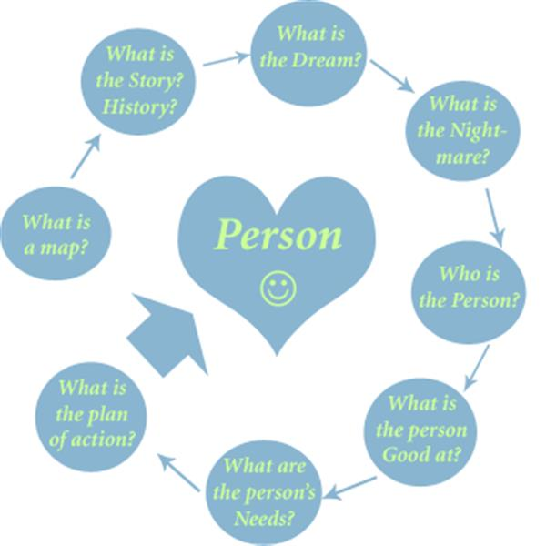
Person-Centered Planning
Encourages formal & informal feedback from the individual about their supports and services, process, and any desired changes.
11

Slide 30
Guiding Principles—8 Essential Elements
Person-Directed.
Person-Centered.
Outcome-Based.
Information, Support and Accommodation
Independent Facilitation.
Pre-Planning (When, where, who, what?)
Wellness and Well-Being.
Participation of Allies.
11

Slide 31
Designing the Individual Plan of Service
These following items are addressed through pre-planning with sufficient time to take all necessary/preferred actions ( invite desired participants). The person is the one who decides this.
When and where the meeting will be held.
Who will be invited (including whether the person has allies who can provide desired meaningful support or if actions need to be taken to cultivate such support).
What will be discussed and not discussed.
What accommodations the person may need to meaningfully participate in the meeting.
Who will facilitate the meeting.
Who will record what is discussed at the meeting.

Slide 32
Designing the Individual Plan of Service
The individual plan of service serves as road map of person’s dreams and desires. The PCP process allows the development of treatment strategies based on informed choices. Informed by:
The hopes, dreams, preferences, values, and desires of consumers (and natural support, where appropriate).
Health and safety needs and concerns of the individual;
The availability or potential development of resources, such a natural supports and other resources;
Funding sources rules;
Procedures matching mental health/developmental conditions to appropriate levels of treatment;
Best practice standards; and
Evidence-based alternatives.
It is the responsibility of the Direct Support Professional to implement the Individual Plan of service during the entire shift.
Person centered plan is offered at least once a year.
12

Slide 33
Designing the Individual Plan of Service
The direct support professionals role is important for them to gather information on the person’s hope and dreams, person’s likes and dislikes, wants, and needs. If an individual is not able to speak for him/herself it is important the direct support professionals to spend time observing activities in the home, community outings, free time and how they respond to people and the direct support professional. It is important that the Direct support professional documentation be accurate because it has effect on the evaluation process and without accurate documentation the adjustments may not be right for the individual’s progress and/or safety.

Slide 34
Self-Determination
Is a natural development of PCP.
Refers to a person’s right to:
Direct their own services
Make decisions concerning their health and well-being
Be free from involuntary treatment
Have leadership roles in the design, delivery and evaluation of supports
Personal resolve and belief in one’s self-development and achievement of personally meaningful life goals
Self-management of disability
Economic independence and prosperity
Recovery is choosing and reclaiming a life full of meaning, purpose and one’s sense of self. People should be able to define
what they need for life they seek, have access to meaningful choices, and have control over their lives.
Michigan Department of Community Health, Community Mental Health for Central Michigan Policy#2.300.015.
12

Slide 35
Characteristics of Person-Centered Plans
PCPs assist individuals to create a personalized image of their desirable future. They are:
Person-Centered
Person-Directed
Capacity Building
Network Building
Outcome-Based
Community Accountability
12

Slide 36
Training Record Instructions
Multiple staff attendees and dates can be on one record.
Separate training records for each trainer.
Training date needs to be at the top of the training record, or next to each staff attendee.
Keep a copy, and then scan into CIGMMO and save as an attachment to the consumer’s Person-Centered Plan or Addendum.
13

Slide 37
Training Record Instructions
Must Complete:
Consumers Name
Date of Birth (DOB)
Case number
Name of the person conducting the training
Date of the training
Print your name in the “Name of Staff Attending” section
13

Slide 38
Health Insurance Portability & Accountability Act (HIPAA)
13

Slide 39
HIPAA
Improves efficiency & effectiveness of health care
Reduces administrative costs through standardization (esp. of claims/billing)
Protect the rights of all consumers of healthcare
Ensure the privacy and security of health information.
Applies to mental and physical health, covering:
Transactions
Privacy
Security
14

Slide 40
Mental Health Providers must comply with HIPAA
14

Slide 41
HIPAA
Privacy notice and acknowledgment.
Adopt and implement privacy policies and procedures.
Train employees about HIPAA.
Provide oversight for privacy procedures.
Protect consumers records.
Follow the “minimum necessary” standard.
Assure that the agency has HIPAA complaint agreements.
14

Slide 42
Consumer Rights
Receive a copy of the agency Privacy Notice
Inspect and copy their case record
A list of disclosures
Request restriction on the use or disclosure of information
Request confidential communication (for example- request not to have the agency send mail to their home address)
14

Slide 46
Limited English Proficiency
Information provided by Community Mental Health for Central Michigan (CMHCM) and Bay Arenac Behavioral Health (BABH)
17

Slide 47
Limited English Proficiency (LEP)
LEP: individual’s inability to speak, read, write or understand English at a level that permits effective interaction with healthcare providers.
Need to recognize and accommodate language limitations
Must be willing and prepared to help them obtain needed treatment and support.
17

Slide 48
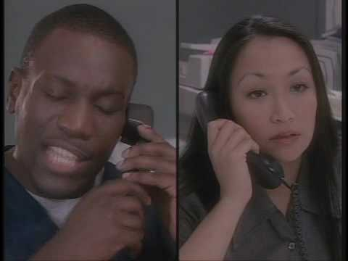
20

Slide 49
The Legal Basis
LEP compliance is our legal obligation; a combination of existing laws, sets of regulations and court decisions.
The United States does not have an official language. English is the most common, but not the legal standard.
17

Slide 50
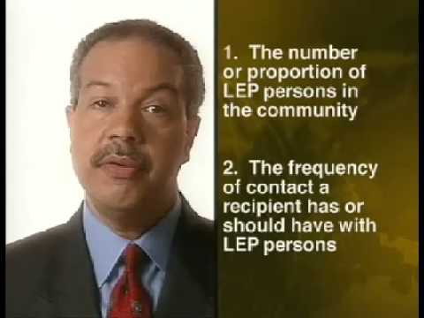
21

Slide 51
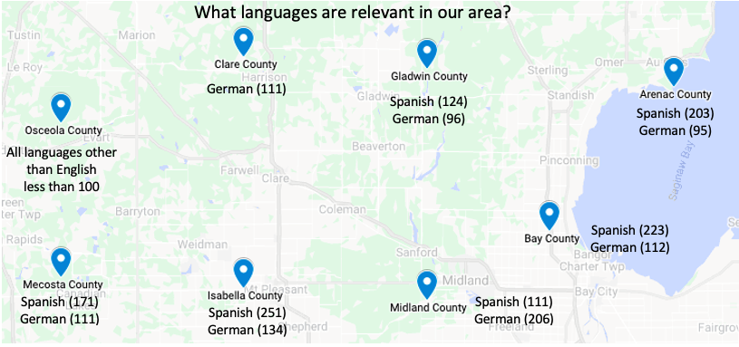
18

Slide 52
Provider Obligations
Examine practices to assure no unintended barriers.
Provide language assistance, at no cost to the individual.
Provide qualified interpreters who are competent in mental health terminology and committed to confidentiality.
Have a plan that includes who we can contact for help with LEP consumers.
We must not allow minors, other consumers, or consumer’s family members or friends to act as interpreters (only in emergency). If consumer chooses a family member or friend it must be documented.
18

Slide 53
Cultural Competence and Diversity
19

Slide 54
The characteristics and knowledge of a particular group of people, encompassing language, religion, cuisine, social habits, music and arts.
19

Slide 55
"Culture encompasses religion, food, what we wear, how we wear it, our language, marriage, music, what we believe is right or wrong, how we sit at the table, how we greet visitors, how we behave with loved ones, and a million other things,"
- Cristina De Rossi, anthropologist
19

Slide 56
Diversity
Gender
Race
Sexual Orientation
Age
Ethnicity
Physical Abilities
What are some other diversities in people you have worked with or known?
19

Slide 57
Cultural Competence
The ability to interact effectively with people of different cultures.
19

Slide 58
Components of Cultural Competence
Awareness of our own cultural worldview
Reactions to people who are different.
Willingness to honestly understand our beliefs and values about cultural differences.
Practice cultural competence, including nonverbal communication.
Most of us must put forth effort to developing this skill.
19

Slide 59
Diversity Education
About valuing diversity.
Allowing, respecting, appreciating differences enhances relationships
Different perspectives can enhance lives and boost morale.
Learn from unique ideas and perspectives
Not about ‘conforming’
19

Slide 60
Communication in a diverse community
Openness
Active listening
Respectful language
Sensitivity
19

Slide 61
24

Slide 62
Infection Control
20

Slide 63
Infection Control
Infection control is preventing the spread of germs that cause illness and infection.
Germs
Starts with understanding them and how they spread.
We come into contact with millions each day.
Need warmth, moisture, darkness, and oxygen to live and grow.
Many germs are harmless and necessary.
Some are very harmful and cause infections, diseases, and illnesses
Infections can be local or systemic
21

Slide 64
Three ways germs are spread
Direct contact - from one infected person to another
Indirect contact - from one infected person to another person through an object
Droplet spread - through the air from one infected person to another
21
Notes:
Open sore, wounds, bodily fluids
Hair combs, drinking glasses, soiled linens
Talk, cough, or sneeze

Slide 65
Controlling the Spread of Germs
Know and practice standard precautions, especially hand washing, mask and gloving.
Keep yourself, the individual, and the environment clean.
Be aware of the signs and symptoms of illness and infection and accurately record and report them.
21

Slide 66
Standard Precautions
Infection control safeguards: hand washing, disposable gloves and personal protective equipment.
Protects both the individual you work for and you from the spread of germs and infection.
Should be used when coming in contact with body fluids, touching mucous membranes (eyes or nose); and when dealing with cuts, abrasions, or wounds.
21

Slide 67
Universal Precautions
Universal Precautions are a set of precautions designed to prevent the transmission of blood borne and air borne virus. That all professionals in the health care system must follow to prevent the spread of virus, and disease. HIV is not the only virus found in blood there are many more.
If you have been exposed or suspect that you have been exposed to an virus, or other known infections you must contact your supervisor to report even if the infection is not contagious
Blood borne pathogens are microorganisms that are present in human blood and other bodily fluids that cause disease.

Slide 68
Body Fluids:
Blood
Blood products
Secretions - Nasal/Semen/Vaginal
Saliva
Vomit
Excretions - Urine/Feces
21

Slide 69
Needlesticks and other sharps injuries are a serious hazard in any healthcare setting. Contact with contaminated needles, scalpels, broken glass, and other sharps may expose healthcare workers to blood that contains pathogens which pose a grave, potentially lethal risk. You may experience a
NEVER RECAP NEEDLES, RAZORS OR ANY OTHER SHARPS!!!
How to Prevent Needlesticks and Sharps Injuries.
If you experience a needlestick or sharp injury or are exposed to the blood or other body fluid of a client during the course of your work, immediately follow these steps:
Wash needle sticks and cuts with soap and water.
Flush/splash the nose, mouth or skin with water.
Irrigate eyes with clean water, saline, or sterile eye flush.
Report the incident to your supervisor.
Immediately seek medical treatment if needed.

Slide 70
Home healthcare workers can be at risk for needlestick or sharps injuries when they:
Handle needles that must be taken part or manipulated after use.
Dispose of needles attached to tubing.
Manipulate the needle on the client.
Recap a needle.
Use needles or glass equipment to transfer fluid between containers.
Fail to dispose of used needles in a puncture-resistant sharps container.
Lack proper workstations for procedures using sharps containers.
Work quickly.
Bump into a needle, a sharp, or another worker while either person is holding the sharp.
Activities with Potential for Needlestick Injuries.

Slide 71
Avoid using needles whenever safe and effective alternatives are available.
Avoid recapping or bending needles.
Plan for the safe handling and disposal of needles before use.
Store sharps containers out of reach of children, pets, and other not needing access.
Secure used sharps containers during transport to prevent spills.
Follow standard precautions, infection prevention and general hygiene practices.
Report needlesticks and other sharps injury immediately to your employer.
Employees should!!
Provided by DHHS(NIOSH)

Slide 72
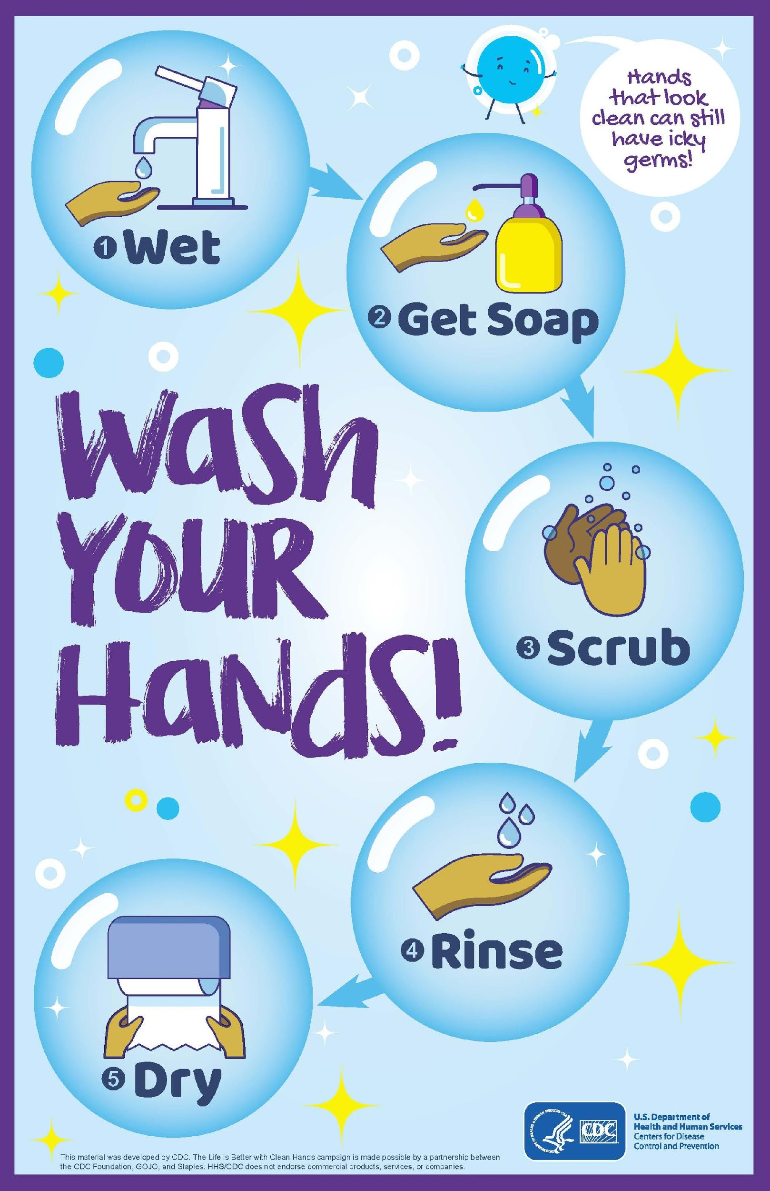
Hand Washing
Frequent, thorough, and vigorous hand washing will help in decreasing the spread of infection.
Before: leaving work, touching food, medicine, kitchen utensils, skin with cuts, sores or wounds, and putting on gloves.
After: coming to work, using the bathroom, sneezing, coughing, or blowing one’s nose; touching one’s eyes, nose, mouth or other body part; touching bodily fluids or secretions; touching soiled clothing or bed linens
21

Slide 73
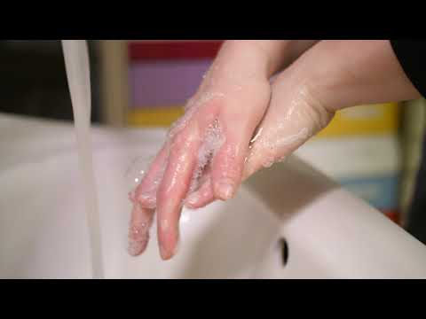
21

Slide 74
Gloves
Putting on disposable gloves and taking them off correctly is especially important in preventing the spread of germs and infection.
Throw away used or contaminated gloves, with new gloves for each individual.
Gloves become contaminated after each use and can spread germs between individuals if used more than once and if they are not properly disposed of.
22

Slide 75
Wear Gloves When
Assisting with rectal/genital/oral care, menstrual care, bathing
Cleaning bathrooms, toilets, bed pans or urinals; or bodily fluids
Giving care when you have open cuts/sores on your hands
Providing first aid
Disposing of waste
22

Slide 76
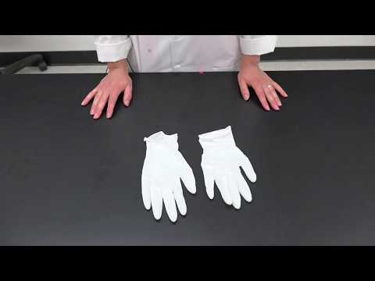
22

Slide 77
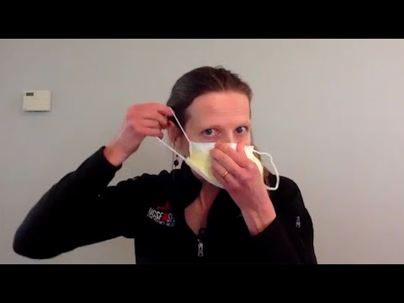

Slide 78
Personal Protective Equipment
You may be expected to wear other Personal Protective Equipment (PPE), such as a face mask or eye shields.
Type of PPE used will vary based on the level of precautions required; e.g., Standard and Contact, Droplet or Airborne Infection Isolation.
Gown
Mask or Respirator
Goggles or Face Shield
Gloves
23

Slide 79
Cleaning and Disinfecting
Prevent the spread of germs through cleaning and disinfecting the environment.
Be careful not to transfer infections to others and/or become infected yourself.
23

Slide 80
COVID-19 Training
COVID-19 is thought to spread mainly through close contact from person-to-person.
Some people without symptoms may be able to spread the virus. Person-to-person spread
Between people who are in close contact with one another (within about 6 feet).
23

Slide 81
COVID-19
The virus that causes COVID-19 is spreading very easily and sustainably between people.
Currently spreading more efficiently than influenza, but not as efficiently as measles.
The more closely a person interacts with others and the longer that interaction, the higher the risk of COVID-19 spread.
May spread in other ways, like by touching a surface or object that has the virus on it and then touching their own mouth, nose, or possibly their eyes.
23

Slide 82
COVID-19
Through respiratory droplets produced when an infected person coughs, sneezes, or talks.
These droplets can land in the mouths or noses of people who are nearby or possibly be inhaled into the lungs.
May be spread by people who are not showing symptoms.
Some viruses are highly contagious, like measles, while other viruses do not spread as easily.
Another factor is whether the spread is sustained (goes from person-to-person without stopping).
23

Slide 83
COVID-19
Spread between animals and people
Currently, the risk of COVID-19 spreading from animals to people is low. Learn about COVID-19 and pets and other animals.
The virus that causes COVID-19 can spread from people to animals in some situations.
Learn what you should do if you have pets.
23

Slide 84
Employee Expectations
Cleansing and Disinfecting
Frequent Handwashing / Hand Sanitizer
Avoid touching
Cover coughs/sneezes
Complete daily screening
24

Slide 85
IF YOU THINK YOU’VE BEEN EXPOSED
CONTACT INFO IN APPENDIX A
24

Slide 86
PAO ACTIONS AFTER CONFIRMED DIAGNOSIS
IMMEDIATE REMOVAL FROM WORKSITE
PARTNER WITH DEPT. OF PUBLIC HEALTH
INFORM IMPACTED EMPLOYEES – 14 DAY QUARANTINE
MAINTAIN CONFIDENTIALITY
24

Slide 87
COVID-19
The best way to prevent illness is to avoid being exposed to this virus.
You can take steps to slow the spread:
Maintain social distance (6 feet).
Wash your hands often with soap and water. If unavailable use hand sanitizer with at least 60% alcohol.
Routinely clean and disinfect frequently touched surfaces.
Cover your mouth and nose with a mask when around others.
Learn more about what you can do to protect yourself and others.
24

Slide 88
Covid-19
PAO COVID-19 Preparedness and Response Plan
PAO aims to protect its workforce by enacting all appropriate prevention efforts. We are continually monitoring guidance from local, state, and federal health officials and will monitor workplace and Plan modifications where/when appropriate.
Employees with questions are encouraged to contact our Services Supervisor via phone at (989) 837-8350 and/or email at Ireland@paomidland.org
COVID-19 Safety Coordinators: Jennie Ireland (Services Supervisor), Kim Armstrong (Quality Assurance/Training Coordinator), Services Coordinators: Amanda Yats, Mike Laskowski, Susan Patterson, Sarah Schardin and Stephanie Grove.
24

Slide 90
Safety & Fire Prevention
25

Slide 91
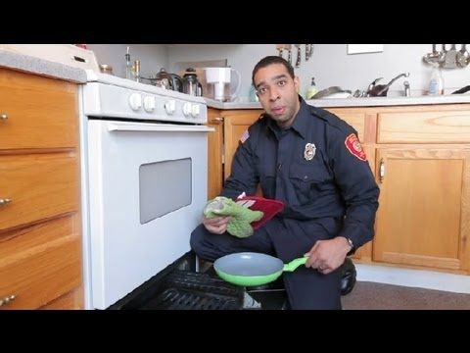
25

Slide 92
You must understand how to react to a fire or smoke emergency.
EVACUATE IMMEDIATELY –at first sign of smoke or fire. Time is the most important factor
26

Slide 93
Don’t re-enter the home!
26

Slide 94
Knowledge about Fires
EVACUATION is priority.
TIME is the most important factor.
CLOSE DOORS on the way out will help contain smoke and fire spread.
KEEP LOW. Smoke rises and is the real killer.
DO NOT RE-ENTER the house!
27

Slide 95
Fire Extinguishment
The only two reasons you should ever use a fire extinguisher are:
RESCUE - if you need to get, to someone to evacuate and fire is in between you.
ESCAPE – if blocking your exit and you need to suppress flames to get the person out.
26

Slide 96
27

Slide 97
If you are trapped
Close Door
Open Window
Stay near Floor
Make Noise
Hang a sheet out window
27

Slide 98
SMOKE DETECTORS
Have enough to provide warning.
Make sure they are properly placed.
Test the detectors monthly.
Replace batteries at least once a year.
Replace the entire detector every 5 years.
27

Slide 99
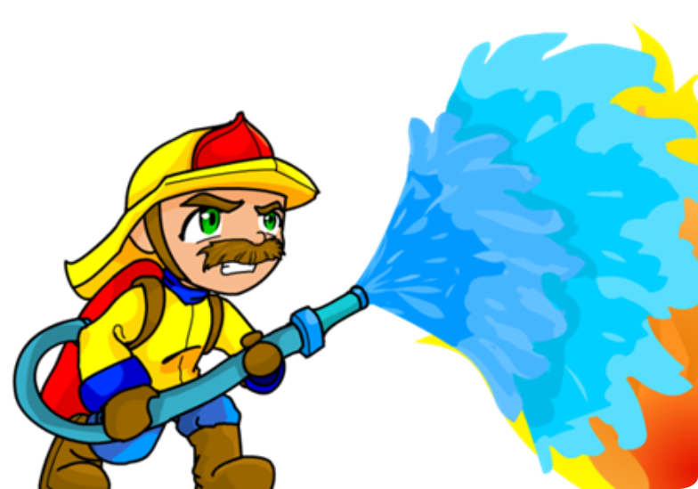
Fire Safety

Slide 100
FIRE DRILLS
Helps you to remain calm and organized when responding to an actual fire or smoke emergency.
27

Slide 101
SAFE DRIVING
This Photo by Unknown Author is licensed under CC BY
OFFICER JEROMY CHURCHILL
OFFICER SARAH NOLEN

Slide 102
Helpful Statistics
Motor vehicle accidents are the leading cause of injury related deaths in the U.S.
According to the CDC National Center for Injury Prevention and Control, approximately 42,000 people will die on the nation's roads and highways each year.
Another 3.5 million people will suffer nonfatal injuries.
Such crashes are the leading cause of death for Americans ages 1 to 34.
Due to the tremendous efforts of many groups over the past 30 years, the number of deaths are declining. These efforts include advances in the design of vehicles and roads, laws requiring and regulating the use of life-saving devices such as safety belts, and changes in societal attitudes toward destructive behaviors such as drinking and driving.
Driving under the influence of alcohol or drugs is a major risk factor for motor vehicle accidents. Prevention programs have significantly helped reduce the number of alcohol related deaths. From 1987 to 1997, alcohol related motor vehicle fatality rates fell 39%. This reduction is due in part to increased public awareness of the dangers of drinking and driving, as well as to tougher laws.
Adults age 65 and older have more fatal crashes than drivers in all other age groups except teens.
Of all age groups, they are the most likely to wear seat belts and least likely to drink and drive or ride with a drunk driver.
To allow for aging, many older adults will adjust their driving habits. Some will stop driving at night due to vision problems, some will stop driving on the freeway or driving during rush hour, and some will stop driving all together.
Other issues that may affect this age group are chronic medical conditions and certain prescription drugs.
In the last 10 years, the number of older drivers has increased by 50%.
As the population ages this number will continue to rise, which in turn will most likely cause the number of traffic deaths to rise.
From 1987 to 1997, the number of traffic deaths occurring among people over the age of 70 increased 22%.
In 1997, almost 6,000 people age 70 or older died of injuries sustained in motor vehicle accidents.
In 1997, 383,000 children under the age of 16 were injured in traffic accidents in the U.S.; more than 3000 were killed. Of these deaths, 70% occurred among children who were passengers in a vehicle.
Death rates for child passengers fell 11% between 1975 and 1996. However, this reduction could be even greater, as 63% of children up to the age of 14 who were killed in accidents during 1997 were not restrained.
Although laws vary, all states now have child restraint laws.
Each year, approximately 80,000 to 90,000 individuals incur a traumatic brain injury (TBI) resulting in long-term, substantial loss of functioning, 64 percent of which are related to automobile accidents. In over half of these, the driver was under the influence of alcohol.
Each year, nearly 11,000 individuals sustain a traumatic spinal cord injury (SCI), also resulting in substantial loss of functioning and permanent disabilities.
More than 190,000 persons in the U.S. live with paralysis caused by SCI. The most common cause of SCI is motor vehicle crashes, accounting for at least 35 percent of these injuries. The length of stay in acute care is generally longer due to other medical problems, often for a total of 3-3.5 months.
The consequences of both TBI and SCI include a dramatic change in the individuals' life course, profound disruption of the family, enormous loss of income or earning potential and large expenses over a lifetime.
When considering costs, there are financial costs and the cost of life. With every death that results from a TBI, on the average, there are 38 years of living lost. The economic consequences of TBI are enormous.
The annual cost of acute care and rehabilitation in the United States for new cases of TBI is estimated at up to $10 billion dollars. Estimates for average lifetime cost of care for a person with severe TBI range from $600,000 to $1,875,000.
These figures may grossly underestimate the economic burden of TBI to family and society because they do not include lost earnings, costs to social services systems and the value of the time and foregone earnings of family members who care for persons with TBI.

Slide 103
AGGRESSIVE DRIVING: Aggressive driving is the operation of a motor vehicle in a manner that endangers or is likely to endanger persons or property. Persons doing any of the following may be committing acts of aggressive driving:
1. speeding
2. running red lights and stop signs
3. tailgating
4. passing on the shoulder of the road
5. cutting off another vehicle
6. slamming on brakes in front of a tailgater
7. improper hand or facial gestures at other drivers
8. yelling
9. repeatedly honking the horn
10. repeatedly flashing of headlights
This Photo by Unknown Author is licensed under CC BY-SA

Slide 104
Aggressive driving is a serious problem that is responsible for many traffic accidents and fatalities. It is your benefit to avoid aggressive drivers and potentially dangerous situations. If you encounter an angry or aggressive motorist:
Do not retaliate or in any way engage the other driver. Get out of the way.
Do not make eye contact.
Keep your doors locked and your windows up.
Keep enough space between you and the vehicle in front of you to pull behind
Do not underestimate the other driver’s potential for aggression.
AGGRESSIVE DRIVING:

Slide 105
Anyone can become an aggressive driver. Do not let stress and frustration get the best of you while driving
Be patient and courteous
Do not drive when angry, overtired or upset
Allow extra time to get to your destination
When possible, change your schedule to avoid congestion.
Listen to relaxing music or books on tape.
Give other drivers benefit of the doubt- all drivers make mistakes.
Avoid all conflict, even if you are right.
AGGRESSIVE DRIVING:

Slide 106
TWO SECOND RULE: Following a vehicle too closely is called “tailgating”. Use the two-second rule to determine a safe following distance
Two-Second Rule
Vehicle Speed | Approximate Feet Vehicle will Travel in 1 Second | 2 Second Rule Distance
25 mph | 37 feet | 74 feet back
35 mph | 52 feet | 104 feet back
45 mph | 66 feet | 132 feet back
55 mph | 81 feet | 162 feet back

Slide 107
MINIMUM AND MAXIUM SPEEDS: Driving too fast or too slowly may create a dangerous situation. Regardless of posted speed limit, weather and traffic conditions may make it necessary to drive more slowly
STOPPING : The ability to stop your care safely should be considered when deciding your speed. Consider the following:
1. how quickly you can react physically and mentally.
2. The type of and condition of the roadway. It will be more difficult and take longer to stop on wet asphalt.
3. the kind of tires you are using and the condition of the tread.
4. the type, condition and adjustment of your brakes
5. vehicle design, weight distribution, suspension and shock absorbers.
VEHICLE SPEED:

Slide 108
Weather can create a driving hazard.
FOG: slow down, drive with headlights on, do not overdrive you headlights, use your turn signal long before you turn
RAIN: increase your following distance, slow down, rain causes serious problems I.E. hydroplaning, cause roads to get slick with dust, oil and leaves
WINTER DRIVING CONDITONS:
Drive slower and increase following distance.
Remove all snow and ice from your vehicle. Clear all windows. Be sure all lights are visible
Start slowly. Gentle braking in slow, steady strokes helps you find out how much traction you have.
Approach bridges, shaded sports, overpasses and turns slowly.
Plan ahead for winter driving. Carrying necessary items in vehicle.
WEATHER CONDITIONS:

Slide 109
CELLULAR PHONE and other devices.
Don’t not do anything while driving that takes your attention away from the road. REMEMBER YOU ARE DRIVING A 3,000 POUND BULLET
This Photo by Unknown Author is licensed under CC BY-NC-ND

Slide 110
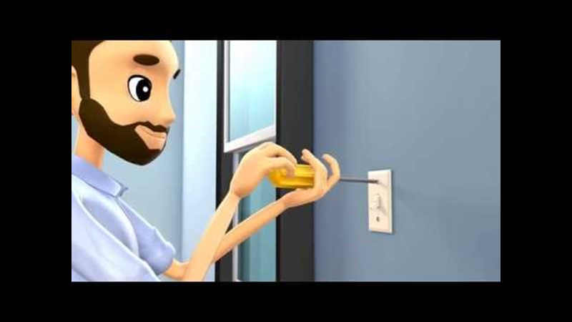

Slide 111
Never overload outlets
Check wires and replace damaged or ‘hot’
Most electrical fires occur in the bedroom
Store appliances when not in use
Turn off power at the source
Electricity can cause physical harm

Slide 112
Cleaning Products
Store in a secure location
Don't mix products
Keep in original containers with labels intact
Cleaning products are intended for external use only. Refer to the product label for emergency information if a cleaning product is swallowed, comes in contact with eyes or if irritating fumes from combined chemicals are inhaled.
U.S. Poison Control Center’s hotline: 1-800-222-1222
Call number listed on the product label.
Call 9-1-1 in an emergency

Slide 113
Disposing of Cleaning Products
General guidelines:
Use all the product. If you can't, give it to another adult.
Follow label directions for recycling/disposal.
Do not mix products.
Do not reuse containers.
Recycle empty containers.

Slide 114
Back Safety and Lifting
Survey the situation.
Tell the individual what you are doing
Get help when you need it
Safe lifting is not graceful

Slide 117
SENSITIVITY TRAINING: HEARING LOSS
27

Slide 118
Hearing Loss
Decreased in hearing sensitivity in one or both ears.
Varies from mild to moderate loss
Many causes: physical conditions such as childhood illness, heredity, injury, age, or prolonged exposure to noise.
Hearing can vary from mild to moderate loss.
Individuals may be able to hear sound but have difficulty distinguishing specific speech patterns in a conversation.
Can affect way sound is experienced, and communication with others.
27

Slide 119
Hard of Hearing vs. Deaf
Hard of Hearing: conditions affect the frequency and/or intensity of one’s hearing; uses individuals use their hearing to assist in communication.
Deaf: describes a more limited group: individuals who do not hear well enough to rely on their hearing to process speech and language.
Profound or total loss of hearing in both ears resulting in not hearing well enough to rely on hearing to process speech and language.
27

Slide 120
ADULT HEARING LOSS
Some who develop hearing loss later in life find it difficult to adjust and behaviorally compensate for hearing loss.
May not use American Sign Language (ASL)
May not be as proficient as individuals who experience hearing loss at birth or at very on age.
28

Slide 121
Preferred Terminology
Acceptable to Neutral:
A person who has a speech disorder
Deaf
Hard of Hearing
Unacceptable to Offensive:
Deaf and dumb
Deaf mute
Hearing impaired
Hearing loss
28

Slide 122
Barriers can be related to:
Access
Attitude
Competency
Safety Risk
Potentially Poor Care
Stress
29

Slide 123
Factors that Influence Understanding
Speaker:
Listeners | Speakers
Level of hearing loss Type of hearing loss Use of hearing aid Use of assistive listening devices Attention level Motivation to hear Expectation Emotional state Fatigue Distracting sensations Distracting thoughts Speechreading skills Tinnitus Tension level Manual communication | Voice intensity Voice projection Rate of speech Clarity of speech Facial expression body language Foreign accent Facing listener Monotonous tone Beard/mustache Emotionality Mannerisms Objects in mouth Interest of message Relationship to listener Quality of interpreter Quality of typist
29

Slide 124
29

Slide 125
Maximizing Hard of Hearing person’s ability to participate in conversation
29

Slide 126
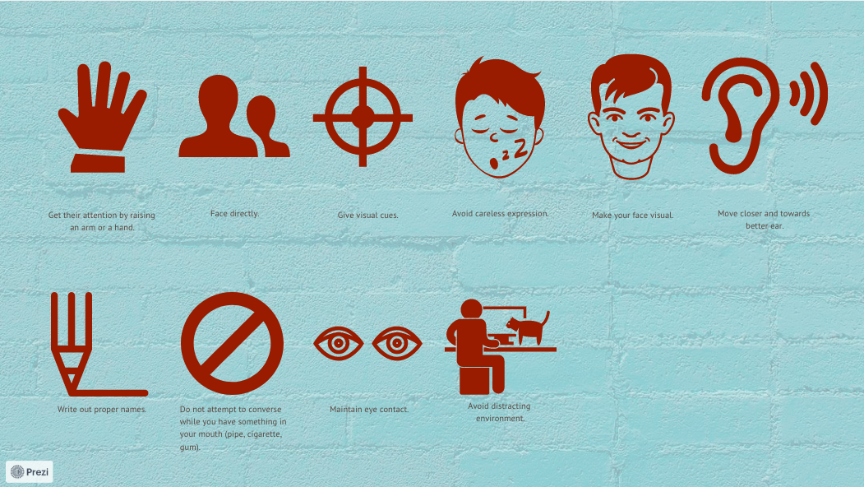
30
Notes:
Non-Verbal Aids

Slide 127
Verbal Aids
Speak slowly and distinctly, pausing more frequently than normally
Do not over-accentuate words
Articulate consonants with special care
Raise volume of voice and keep your voice at same volume; do not drop voice at end of sentence.
Talk in normal/lower voice
Ask HOH person for comfortable voice level
Pronounce names with care; make a reference to the name if possible
Change to a new subject at a slower rate
Use shorter phrases
Do not show annoyance by careless facial expression
In a group, repeat important statements
30
Notes:
Verbal Aids

Slide 128
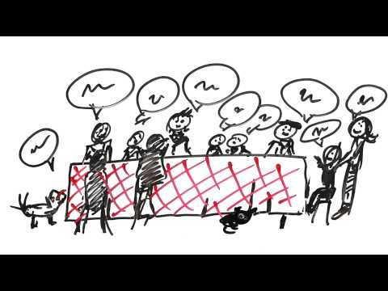
30

Slide 129
Guidelines for better communication
31

Slide 130
Adapting the Environment
Eliminate or decrease background noise
Place person in strategic place to hear; consider sitting closer
Use furnishings that absorb sound and reduce resonance
Modify Lighting and seating arrangements
Avoid use of intercommunication systems
One person speaking at a time
Review Speaker Tips in Participant Guide pg. 29
31

Slide 131
Communication with Deaf or Hard of Hearing individuals
Learn about them - ask for tips and what they prefer
Observe for understanding
Rephrase, not repeat.
Text Messaging
TTY
31

Slide 132
Trauma Informed Care
32

Slide 133
32

Slide 134
What is Trauma?
Experience that puts a person or someone close to them at risk of serious harm or death.
Causes an overwhelming sense of terror, helplessness, and horror
Produces physical changes such as a pounding heart, rapid breathing, trembling, dizziness, or loss of bladder or bowel control
32

Slide 135
Types of Trauma
Acute Trauma: single event
Chronic Trauma: repeated and prolonged
Complex Trauma: the experience of multiple traumatic events
Specific kind of chronic trauma
Exposure to varied and multiple traumatic events
32

Slide 136
Complex Trauma Post Traumatic Stress Disorder (PTSD)
32

Slide 137
90% of people fit the traumatic event criteria in DSM-V
33

Slide 138
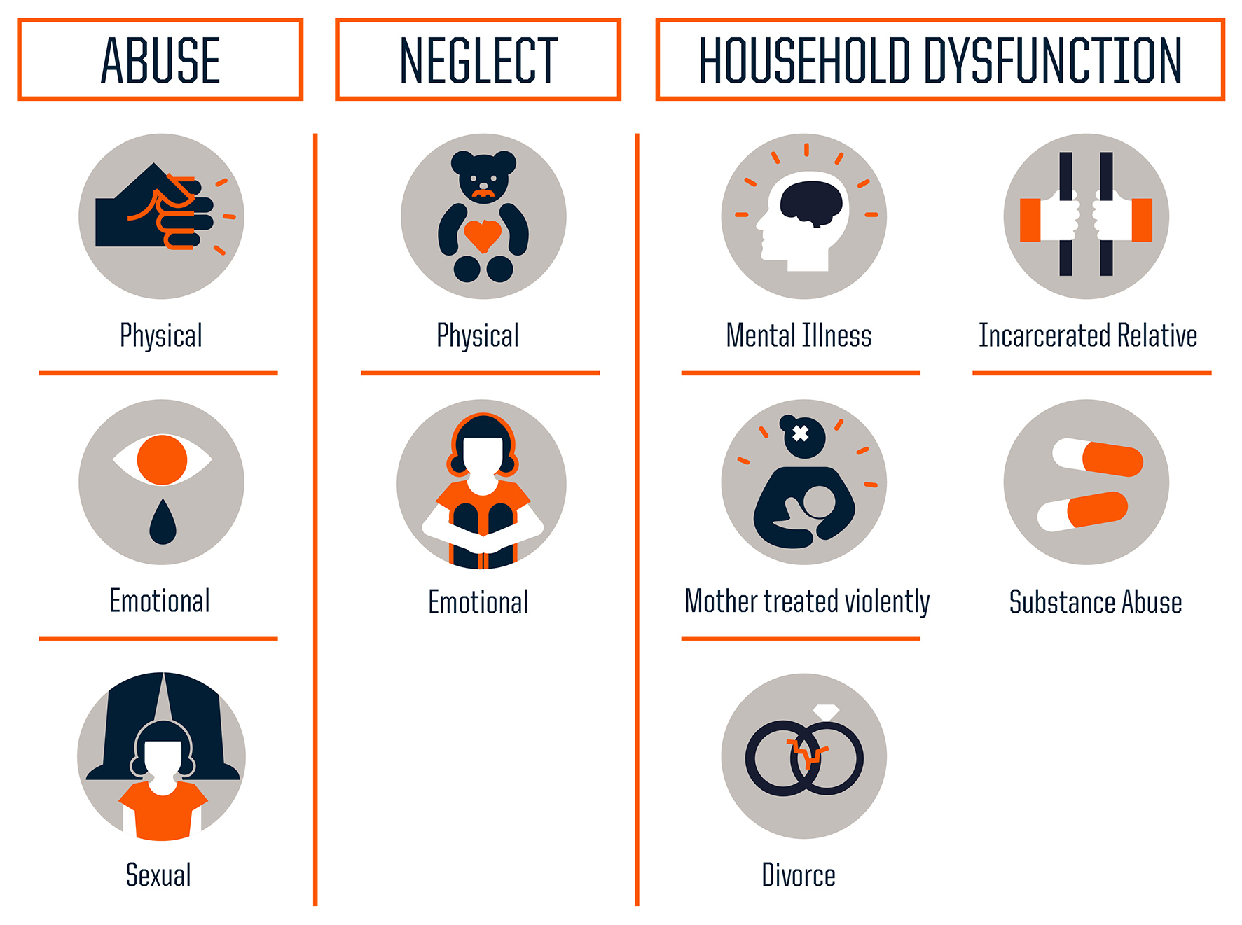
ACES - Adverse Childhood Experiences Scale
Source: Centers for Disease Control and Prevention
Credit: Robert Wood Johnson Foundation
33

Slide 139
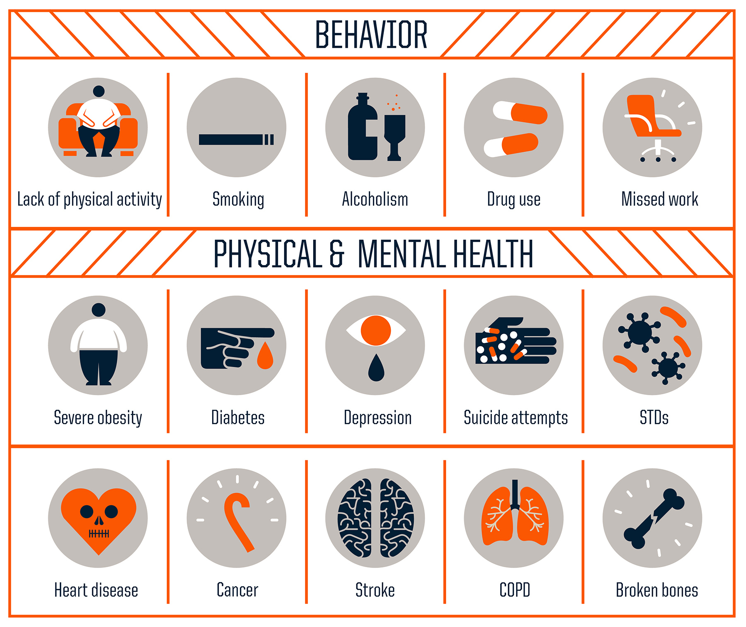
ACEs Increases Health Risks
34

Slide 140
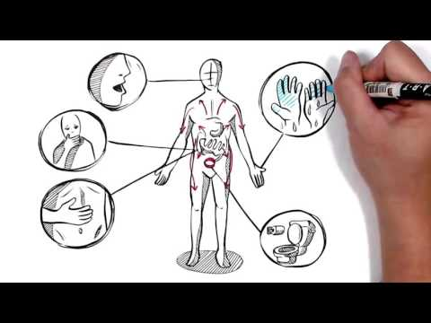
34

Slide 141
Responses to Trauma
Hyperarousal:
Re-experiencing:
Avoidance and withdrawal:
Nervousness, jumpiness, quickness to startle
Intrusive Images, sensations, dreams
Intrusive memories of the traumatic event or events
Feeling numb, shut down, or separated from normal life
Pulling away from activities and relationships
Avoiding things that prompt memories of the trauma
34

Slide 142
Universal Precautions Approach
Assume ALL individuals we serve have experienced trauma and amend our practices accordingly.
35

Slide 143
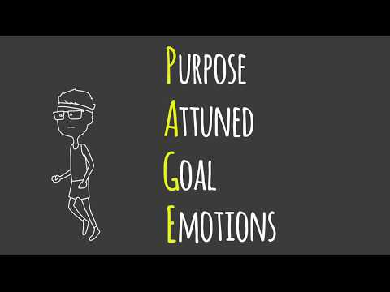
35

Slide 144
Coping with Trauma Reminders
Stop:
Orient:
Seek:
Take several long, deep breaths.
Look around and take in where you are and what’s going on in your body.
Call a friend or practice square breathing.
35

Slide 145
Basic Medication Administration
Information provided by Community Mental Health for Central Michigan (CMHCM) and Bay Arenac Behavioral Health (BABH)
35

Slide 146
Medications are substances that are taken/applied to the body to prevent, treat, relieve symptoms, or cure.
35

Slide 147
Many people take at least one or more medications daily, and everyone will need medication at one time or another.
Follow orders exactly.
Safety is key to preventing medication errors.
Learn about each medication: why they are taking it, side effects, how to know if it is working, foods or drinks that should be avoided, other medications that should be avoided, will it prevent the individual from doing activities, etc.
Keep the individual informed about their medications and answer any questions they have.
35

Slide 148
Medication Types
Prescription medications
Over-the-counter (OTC)
PRN Medications
36

Slide 149
Direct Support Professional (DSP) may assist with administration of medications that have been ordered and prescribed. Follow preparation and administration instructions.
They are powerful and can impact the overall health, behavior and ability to prevent, combat or control disease.
Effect everyone differently.
Taken for an effect or action: controlling seizures, lowering blood pressure, or relieving pain.
Side effects: actions other than the intended
Some are predictable; others are not. May be desirable or undesirable, harmless or dangerous (or deadly).
It is not uncommon for two or more medications to interact with one another, causing unwanted side effects.
36

Slide 150
Common Medication Categories
Classified with other medications that affect the body in similar ways.
Many drugs have multiple uses and can be found in more than one category.
Some common categories of medications used by individuals with developmental disabilities or Mental illness include:
Anticonvulsants
Antibiotics
Pain Medication
Psychotropic Medications (including antidepressants)
36

Slide 151
Anticonvulsants
Seizures can be treated by anticonvulsants.
The type of seizure an individual has determines which anticonvulsant the physician prescribes.
Common anticonvulsants are Depakene, Tegretol, Neurontin, Lamictal, Topamax and Keppra.
Many anticonvulsants may interact with other drugs.
Some anticonvulsant deplete vitamins; be sure to ask the physician or pharmacist.
Several substances may lower the “seizure threshold” or increase the likelihood of a seizure.
Most anticonvulsants have central nervous system effects including on thinking (especially Phenobarbital), dizziness, sedation, mood changes, nervousness, or fatigue.
36

Slide 152
Anticonvulsant Side Effects
Sleepiness, lethargy, cognitive impairment (especially Phenobarbital), altered gait, seizure breakthrough, and memory loss are typically related to the dosage.
Stomach upset (especially with Tegretol, Depakote), diarrhea, gum growth, and swelling (with Dilantin), weight gain, and hair loss or growth.
Liver or Kidney dysfunction, hyperactivity, aplastic anemia, allergic response.
37

Slide 153
Anticonvulsant Side Effects
To learn about side effects of a particular medication:
Talk to the prescribing doctor
Talk to the pharmacist
Cross-reference medication reference books from your local library or bookstore.
Use websites such as safemedication.com or drugconsult.com
Make sure that you know the answer to all these questions before you assist an individual in taking a medication.
37

Slide 154
Psychiatric Disorders
Psychiatric disorders may involve serious impairments in mental or emotional functioning, affecting ability to perform normal activities and to relate effectively to others.
Many individuals with developmental disabilities also have a psychiatric disorder, and individuals who have been diagnosed with a mental illness are treated with psychotropic medications.
37

Slide 155
Psychotropic medications
Psychotropic medications are central nervous system drugs that affect mental activity, behavior, or perception; three categories.
Note: Antipsychotics and Antidepressants require “informed consent”. The parent, guardian, or individual must give consent for the medication to be administered in a residential setting.
37

Slide 156
Psychiatric Disorders
1. Mood Disorders: depression and bi-polar disorder.
Depression: (lasting two or more weeks), can manifest as feeling of hopelessness or even self-destruction; for example, not wanting to eat or get out of bed in the morning/ Antidepressants are used to treat depression.
Bipolar Disorders (Manic Depression): often marked by extremes in mood (elation to deep despair) and/or manic periods of excessive excitement, delusions of grandeur, or mood elevation.
37

Slide 157
Psychiatric Disorders
2. Schizophrenia: Can mean hallucinations and sensory misperceptions; delusions; distorted misinterpretation and retreat from reality; ambivalence; inappropriate affect; and bizarre, with drawn, or aggressive behaviors.
3. Anxiety Disorders: Typified by tension, fear, apprehension, discomfort, and distress. Two main types are:
Generalized Anxiety Disorders
Obsessive-Compulsive Disorder
37

Slide 158
Following Doctor’s Orders
Some medications (Tylenol, Lithium, Depakene) can be toxic and cause damage.
Everyone responds differently to medications; how quickly our bodies can break down (metabolize) the medication.
May start a new medication at low doses and increase in response to signs of positive effects.
Checking blood serum levels can be important.
Physician’s orders for lab tests and follow-up appointments must be followed.
37

Slide 159
Monitoring for the Effects of Medication
Know Effects
Observe
Document
Report
Follow Directions
Monitor
38

Slide 160
Common Side Effects (Report To The Doctor):
Abnormal movements (face, tongue, or body)
Muscle pain
Stooped posture
Blank facial expression
Feeling dizzy or lightheaded
Dry mouth
Constipation
Blurred vision
Diarrhea
Nausea
Vomiting
Increased risk of sunburn
Skin Rash
Increase heart rate or feeling heart is racing
Change in sleep
Decreased energy
Sedation
Changes in weight or eating patterns
Tremors, shakiness
Balance problems
Shuffling when walking
Confusion
Change in ability to concentrate
Hyperactivity
38

Slide 161
Tardive Dyskinesia
A potential long-term neurological side effect of antipsychotic medications (e.g., Mellarill, Thorazine, Risperdal, Zyprexa).
Symptoms include rapid eye blinking; puckering, or chewing motions of the lips and mouth, or facial grimacing.
You should monitor individual for these serious side effects on a regular basis.
When taking antipsychotic medication, complete Abnormal Involuntary Movement Scale (AIMS) every six months.
38
Notes:
Who would ever guess that taking your blood pressure medication with grapefruit juice instead of orange juice could make you sick. Or that licorice could be lethal when eaten with Lanoxin or Lasix. How could cheddar cheese, pepperoni pizza, or pickled herring combined with an antidepressant create a hypertensive crisis? Yet all of these interactions are real and could lead to disaster.

Slide 162
Medication Interactions
Interactions between two or more drugs, drugs and food and/or drinks.
Can be caused by alcohol, particularly in combination with:
Antianxiety drugs (Librium, Valium, Xanax)
Antidepressants
Anti Seizure medicines
Antihistamines
Ulcer and heartburn drugs (Zantac, Tagamet)
Some heart and blood pressure medicines.
38

Slide 163
Guidelines for Reporting a Suspected Adverse Reaction
Urgent medical care may be needed. Report reaction to the doctor and follow advice. Be prepared to share:
A list of current medications | how they look | any changes in behavior or level of activity | description of what they say is wrong or is hurting | when the symptoms first started |changes in bodily functions | recent history of similar symptoms, injury, illness, or chronic health issues | known allergies to food or medication
39

Slide 164
Severe, Life-Threatening Allergies
Anaphylactic Shock: generalized systemic reaction, frequently fatal, which usually occurs within minutes after contact with an allergen.
Allergic reaction is sudden and severe, signs include:
Wheezing or difficulty breathing
Swelling around the lips, tongue, or face
Skin rash, itching, feeling of warmth or hives.
Should wear an ID bracelet with information about the allergy.
Call 911 immediately to get emergency medical care if signs develop, especially soon after taking a medication.
39

Slide 165
Reading and Understanding Medication Labels
39

Slide 166
Pharmacist uses doctor’s written order & places label on container providing instructions. Understand the label to safely administer medications.
Doctor’s order/pharmacy label may show medications by either generic or brand name.
For example, acetaminophen is the generic name for Tylenol. Tylenol is the trade or brand name.
Each medication must be kept in its original container with the pharmacy label attached for safety.
39

Slide 167
PHARMACY NAME AND ADDRESS
PHARMACY PHONE NUMBER
PRESCRIBER’S NAME
PRESCRIPTION NUMBER
The Pharmacy
123 Main Street
Town, USA 12345
800-555-5555
INDIVIDUAL’S NAME
DR. SARAH DOE
DATE: 08/20/2020
DATE FILLED
No. 0012345-67890
Jane Smith
456 Main Street Town, USA 12345
DIRECTIONS
MEDICATION NAME
TAKE ONE CAPSULE BY MOUTH THREE TIMES DAILY
AMOXICILLIN 500MG CAPSULES
STRENGTH/DOSAGE
QTY 30
USE BEFORE 01/20/2021
EXPIRATION/ DISCARD DATE
NO REFILLS – DR. AUTHORIZATION REQUIRED
QUANTITY
NUMBER OF REFILLS
40

Slide 168
Common Abbreviations and Symbols
Rx = Prescription OTC = Over the Counter p.r.n. = when necessary or as needed q (Q) = every t.i.d. (TID) = three times a day oz = ounce D/C or d/c = discontinue mg = milligrams Cap = capsule cc = centimeters A.M. = morning | TBSP = tablespoon (3 tsps. Or 15 ml) h. = hour Qty = quantity b.i.d. (BID) = twice a day q.i.d (QID) = four times a day BT = bedtime hs = hour of sleep STAT = Immediately GM, gm = grams (1,000 mg) Tab – tablet P.M. = afternoon/evening
40

Slide 169
Medication Dosage
Dose is a term used to describe how much medication or how many units are to be taken at any time. A dose can be described as a single dose or a daily dose. For example, an oral medication (capsules or tablets) may be prescribed as:
Amoxicillin 500mg capsules In this example the individual is taking 500mg
Take 1 capsule 3 times daily single dose and a 1500 mg daily dose
Tegretol 200 mg tabs In this example the individual is taking 2-400mg
2 tabs at 7a.m. 2 tabs at 2p.m. single doses, and 200 mg single dose and a
And 1 tab at 9p.m. 1000 mg daily dose
A liquid medication may be prescribed as:
Amoxicillin 250 mg/5cc In this example the individual is taking a 5cc
Give 5cc (5cc= 1 teaspoon) single dose and a 20cc daily dose
4 times a day of Q.I.D.
40

Slide 170
Label Warnings
Medication Should Be Taken with Plenty of Water For External Use Only May Cause Drowsiness or Dizziness May Cause Discolored of the Urine or Feces Finish All of This Medication Unless Otherwise Directed by Prescriber It May be Advised to Drink a Full Glass of Orange Juice or Eat a Banana Daily Take Medication on an Empty Stomach 1 hour before or 2 hours after a Meal Unless Otherwise Directed by Your Doctor Do not take with Dairy Products, Antacids or Iron Preparations Within One Hour of this Medication
41

Slide 171
Examples of Medication Containers
41

Slide 172
Learning About Medications
41

Slide 173
Medication Sheets (Documentation)
Includes key information about the individual, including any known drug allergies, and information about the individual’s medications, including the name of the medication, dose, and the times and way the medication is to be taken.
Most pharmacies will print a medication sheet for home use, if requested.
If not, DSP should create one.
Transcribe (transfer information from the medication label on the prescription to the medication sheet)
When possible, place pre-made medication and warning labels (from the pharmacy) should be placed on medication sheet (e.g., “take with food”).
41

Slide 174
Medication Sheets (Documentation)
Set up one person’s medication at a time.
Record each dose of medication taken (or missed), date and time
Document each dose of medication given immediately after administration
Update Medication Sheet as prescription changes.
42

Slide 175
Five Rights of Assisting with Medication Administration.
Following the Five Rights is a basic to medication safety. Must have the:
Right INDIVIDUAL
Right MEDICATION
Right DOSE
Right TIME
Right ROUTE
Following the Five Rights each time is the best way for the DSP to prevent medication errors.
43

Slide 176
Five Rights of Assisting with Medication Administration.
Check the Five Rights three times by reading the medication label information and comparing it to the Medication Sheet as follows:
First Check: removing medication from storage area
Second Check: when you remove the medication from the original labeled container
Third Check: just before you assist the individual to take the medication
Record that the individual took his or her medication by initialing the date and time in the proper box on the Medication Sheet.
43

Slide 177
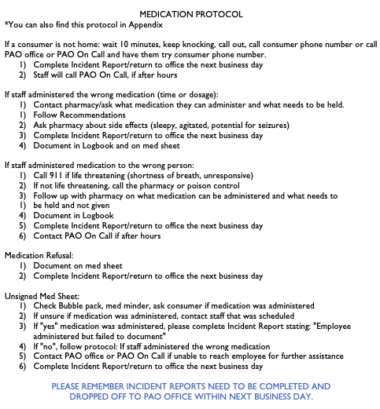
43

Slide 178
Needlesticks and other sharps injuries are a serious hazard in any healthcare setting. These injuries may occur when you are assisting your consumer during any medications that are in a syringe/needle or when checking the blood.
NEVER RECAP NEEDLES, RAZORS OR ANY OTHER SHARPS!!!
How to Prevent Needlesticks and Sharps Injuries.
If you experience a needlestick or sharp injury or are exposed to the blood or other body fluid of a client during the course of your work, immediately follow these steps:
Wash needle sticks and cuts with soap and water.
Flush/splash the nose, mouth or skin with water.
Irrigate eyes with clean water, saline, or sterile eye flush.
Report the incident to your supervisor.
Immediately seek medical treatment if needed.

Slide 179
Positive Approaches to Challenging behaviors, non-aversive techniques & crisis Interventions
Information provided by Community Mental Health for Central Michigan (CMHCM) and Bay Arenac Behavioral Health (BABH)
44

Slide 180
Overview to positive behavior support
Behavior is communication
Verbal vs. Non-Verbal
Develop Relationships
Behavior can be “imitated”
Interactions Matter
Choices are essential
44
Notes:
Your role as a Direct Support Professional has an immediate impact everyday on the people to which you provide services.
You will experience, over time, the incredible importance and value of relationships.
On that amazing journey you will discover that you are building a better and healthier world and community for the sake of humankind.
You may also discover that you are helping to take away the isolation in people’s lives, bringing equalities that all citizens have a right to, an offering care and compassions to those who sorely need it.
In your work as a Direct Support Professional, you given the opportunity to help instill in people a sense of value and dignity.
This leads to healthier self-confidence and self-esteem and, along with your encouragement as a role model, may inspire others to give rather than habitually take.
Finally, you are bringing hope and light to people and their communities: and you will discover that with out you’re the difference might never have been felt.

Slide 181
The Goal of Teaching
To support individuals with disabilities and/or mental illness to live independently and with as much enjoyment as possible.
How do we know what skills to teach?
Functional?
Relevant?
Age-appropriate?
Support independence?
Naturally reinforced?
44

Slide 182
Does everything have to be functional?
Free time activities are separate than skills.
We usually choose things that make us happy, even if it isn’t functional.
Direct Support Professionals (DSPs) support people, not control behaviors.
Encourage other interests if needed
44

Slide 183
Teaching during daily routines
Provide teaching support they need when they would naturally use those skills. Practice may lead to gaining independence in using it.
Importance increases likelihood to be learned and maintained.
Look for opportunities to teach throughout the day and in all environments.
Doing these routines independently / doing them to the best of our abilities, leads to control over our lives.
Find balance between teaching and just letting people enjoy some “free time.”
45

Slide 184
Guidelines for Effective Teaching
Plan
Build in Variety and Choices
Prevent mistakes before they happen
Make the teaching Experience successful
Provide Prompts when necessary
Reward before, during, and after session
Keep the flow going
Be aware of going ons during session
46

Slide 185
Behavior
Behaviors are a form of communication people use to tell us their wants, needs, and feelings.
All of us have behavior. Behaviors don’t happen without reason.
All behaviors is intended to communicate something.
“Listen” to what behavior is saying
There is always a reason for a given behavior
47

Slide 186
Challenging Behavior
Behaviors are usually considered challenging if they:
Cause harm to individual or others.
Cause property damage.
Causes person to be “labeled” as a behavior problem.
Prevents person from learning new skill
Prevents person from participating in social and recreational activities.
What is making challenging behavior “work” ?
Work with the PCP team to determine why behavior is happening and teach
replacement behavior.
47

Slide 187
Challenging Behavior
Behaviors revolve around who / what / where the individual is involved in.
There are most likely patterns; challenging behaviors are displayed because it has worked in past.
Any attention may seem better than none at all, reinforcing behaviors.
47

Slide 188
Challenging Behavior
Behavior is communication.
Behavior usually communicates three things:
What individual wants
What the individual doesn’t want
When the individual wants attention
How would an individual’s behavior tell you that they want something?
48

Slide 189
Challenging Behavior
Individuals might just want attention.
Observe behaviors during good and bad times
Listen carefully to words, sounds, noises, or cries
Ask questions to find out what is going on / what they may need
48

Slide 190
Challenging Behavior
Antecedent: occurrence or event that takes place before the challenging behavior happens.
Precursor: sign that can happen before a challenging behavior.
How we respond has direct impact on person’s response.
How we say something determines message we are giving and their response.
Tone of Voice: 38% of communication.
Body language: 55% of communication.
Actual words: 7% of communication.
48

Slide 191
Challenging Behavior
Mistakes happen; always stay aware of your communication style.
Remember you are a “Role Model” and your behavior can be imitated.
48
Notes:
This is important to remember when relating with the people who live in the home and also when relating with your co-workers. Think about how someone may have said something to you that made you not want to do what they requested. If someone says “you need to clean this mess up right now!” and does not consider that you may be busy doing something else, or that it is someone else’s job, or that you need help, you may respond by not being very nice and definitely not wanting to clean up the mess. This may affect your mood and how you feel about the person. If someone says “I can see a mess here that needs to be cleaned up. Can you do this now or are you busy doing something else? Would you like some help?” You might be much more willing to clean up the mess if you were asked in a nice way to do it. You might even stop what you are currently dong to clean up the mess because you like the way this person treats you and you like to do what they ask of you.

Slide 192
Challenging Behavior
How you make or respond to a request has dramatic impact on whether they will comply.
Be respectful. “Think before you speak”!
Our goal is to have “Win-Win” responses. consider:
Is this an activity that the individual likes?
Is this an activity the individual knows how to do or needs help with?
Is the individual already busy?
Does the individual have a choice about when or how to do the activity?
Are you asking in a way that “YOU” would like to be asked?
49

Slide 193
Promoting Positive Behavior
What / where / who affects behaviors
Behaviors: strategies individuals use to get their needs met. Part of your job is to figure out which social/communicative behaviors currently work best for an individual.
Environmental influence: Make sure living environments affect them in a positive way.
Behavior is communication. Listen and observe behavior to discover its purpose
49

Slide 194
Proactive options:
Select proactive options in dealing with challenging behaviors.
Recognizing times when teaching is not likely to occur, and having an alternate plan of action.
Be able to indemnity Antecedents and Precursors to challenging behavior.
Understand how to respond effectively in handling challenging behavior.
49
Notes:
After reviewing this material you will be able to select pro-active options in dealing with challenging behaviors, including:
Recognizing times when teaching is not likely to occur, and having an alternate plan of action.
Be able to indemnity Antecedents and Precursors to challenging behavior.
Understand how to respond effectively in handling challenging behavior.
Often times when we are working on a task with someone we may keep pushing for the task to get finished without taking notice of an individual’s minor behavior changes or change in mood. Our focus may be more on the task than the person. We may feel pressure to want to get the task done. If a challenging behavior is starting to happen it is a clear signal that we have to change something in our teaching plan. Failure to change our plan may results in a different lesson learned that we intended.
Focusing on the task as the most important outcome may start to have an effect on relationship with the individual. The person (the learner), may become more frustrated with the task and you (the teacher), since completion of the task is so important to you. Failure to recognize the needs of or mood changes in the learner can cause the challenging behavior to increase to a point where closer in a friendly, trusting atmosphere is impossible. Our failure to adapt or be willing to make changes for the individual may be perceived as wanting too much “control” over the individual trying to learn.

Slide 195
Proactive options:
Might be focused more on a task than the person:
When challenging behavior starts, review teaching plan.
Focusing on task as most important outcome may help influence relationship with the individual.
Challenging behavior can increase to a point where a friendly, trusting atmosphere is impossible.
May be perceived as wanting too much “control” over the individual
49
Notes:
After reviewing this material you will be able to select pro-active options in dealing with challenging behaviors, including:
Recognizing times when teaching is not likely to occur, and having an alternate plan of action.
Be able to indemnity Antecedents and Precursors to challenging behavior.
Understand how to respond effectively in handling challenging behavior.
Often times when we are working on a task with someone we may keep pushing for the task to get finished without taking notice of an individual’s minor behavior changes or change in mood. Our focus may be more on the task than the person. We may feel pressure to want to get the task done. If a challenging behavior is starting to happen it is a clear signal that we have to change something in our teaching plan. Failure to change our plan may results in a different lesson learned that we intended.
Focusing on the task as the most important outcome may start to have an effect on relationship with the individual. The person (the learner), may become more frustrated with the task and you (the teacher), since completion of the task is so important to you. Failure to recognize the needs of or mood changes in the learner can cause the challenging behavior to increase to a point where closer in a friendly, trusting atmosphere is impossible. Our failure to adapt or be willing to make changes for the individual may be perceived as wanting too much “control” over the individual trying to learn.

Slide 196
Proactive options:
Not about establishing control.
Include individual in the full planning process.
Guidelines assist us in making “on-the-spot” changes
Response based on emotions may include poor body language / inappropriate voice tone.
We may become “bossier” and try to take too much control over the person. To avoid this type of reaction we must have a plan of action ready to implement.
49

Slide 197
Proactive options:
If we know the individual well, we should be aware of the type of challenges we typically face with this person.
Plan actions ahead of time, before teaching session.
Learn from past and use experiences to improve/plan better future teaching sessions.
“Proactive Options” will help identify potential responses to challenging behavior.
49

Slide 198
Proactive Options: Quality of Interaction:
Change your energy level
Modify your tone
Validate the learner’s feelings
Improve and vary rewards
Change your expectations
Abandon the task to focus on the person
50

Slide 199
Proactive Options that reduce the demand on the learner
Change the pace of the activity
Involve choices
Modify the environment
Improve the prompt
Take a mini-break
Bail out
Hang in there
50
Notes:
(These options may enhance the quality of the interaction between the teacher and the learner with less time and effort being spent on the task to be done. ):

Slide 200
Confrontation Avoidance Techniques (C.A.T.)
Standard procedure unless IPOS has a behavior treatment plan
If an ongoing treatment plan exists to assist with their Challenging Behavior, follow it carefully.
DSPs should receive specific training for each IPOS.
Call another worker for help if needed.
DSP with “best” relationship with the person usually has most success with helping person calm down.
51

Slide 201
YOUR Responsibilities
Avoid confrontation
Know how to calm a person down
Use common sense techniques to calm down agitated person.
Better relationships lead to better chance these techniques will work for you.
Think of a time in the past where you were upset or agitated.
If you needed someone to calm you down which would you choose?
A stranger or someone you know well and feel comfortable with?
51

Slide 202
Always:
Avoid situations that may upset the person/confrontations.
Reward “good” behavior.
Show care and concern daily.
Actively listen.
Be fair, firm, and consistent. DSPs work as team providing consistent treatment.
Get to know the individual, and the earliest signs of agitation.
Stay in control of yourself - voice tone and body language.
51
Notes:
Reward “good” behavior a much as possible. When you see it…reward it!!!!
Show care and concern daily; not just when a person becomes upset.
Actively listen. Stop what you are doing and pay close attention to the person.
Be fair, sometimes firm, and consistent. It is important for all DSP’s to work together as a team to provide consistent treatment. This is the “key’ to successfully teaching people appropriate social skills.
Get to know watch person you provide services to. Learn the earliest signs of agitation so you cam intervene at the beginning of the problem.
Look out for and avoid events or situations that may upset the person. Remember it is our responsibility to avoid confrontations. People who display challenging behaviors on a regular basis may be living in this home to learn some appropriate ways to deal with their emotions. This will be an important part of your job.
Stay in control of yourself. Be aware of your voice tone and body language. If you show signs of anxiety, this may increase the person’s agitation.

Slide 203
When agitation is beginning:
Use whatever works “best” for individual based on their challenging behavior and communication style.
Approach immediately and talk to the person.
Remain calm, friendly, and positive. Stay in control of your actions.
Invite the person to sit with you or stand with the person if they refuse to sit.
Speak in a low, calm voice, slowly and speaking clearly.
51

Slide 204
When agitation is beginning:
Ask what the problem is.
DO NOT: demand, command, argue, disagree, or make any threats.
Remember these are “beginning” signs of agitation.
Don’t bribe or promise what you can’t deliver.
Be patient.
51

Slide 205
When agitation is increasing:
Do what works best based on your relationship with the person you are trying to calm down.
Calm, relaxed voice at low volume.
Manage your emotions and your body posture. Stay neutral and relaxed.
Talk to the person, listen to them, and be patient. Time is on your side.
Acknowledge their feelings.
Never turn your back or walk away. Stand slightly to the side of the person, at an angle, face to face, maintaining eye contact. Let them move around if they need to. Call for help from another DSP.
Do not disagree, argue, command, demand, or make threats.
52
Notes:
Continue to “be patient” and do not give up working with these techniques, unless you are scared, and know the person will continue to escalate to the point of attacking someone, time is on your side.
Keep your body posture relaxed. Try not to show it if you are feeling tension. Remember your body language represents 55% of your communication.
Stand slightly to the side of the person, at an angle, face to face, maintaining eye contact. This especially important if you feel or know the person has the potential to attack you physically. You are in a better position to move away from the person to attack you physically. You are in a better position to move away from the person quickly by standing t the side of the person.
Stand at an arm’s length, plus a few inches away from the person. This goes along with the previous technique. As you stand to the side try to put yourself at a safe distance from the person. If they try to reach out, hit, or grab you will have time to move away.
Never corner the person and do not allow yourself to be cornered. Most people need space to move around if they are extremely upset or agitated (This is true for all of us). When someone is the agitated you need to make sue you always have an avenue of escape and don’s get yourself blocked into a corner or up against a surface. Making the person do so say something they don’t want to do may still make them feel cornered (psychologically). Cornering any person who is agitated, angry, or scared is highly dangerous.

Slide 206
C.A.T. worked! Agitation is Decreasing
Remain with them until they completely calm down.
Involve the person in an activity (their choice!) before you leave the scene.
Do not blame, punish, or scold the person for the challenging behavior.
It may be appropriate to talk to the person about their challenging behavior.
Document what happened, including any “good news.”
52

Slide 207
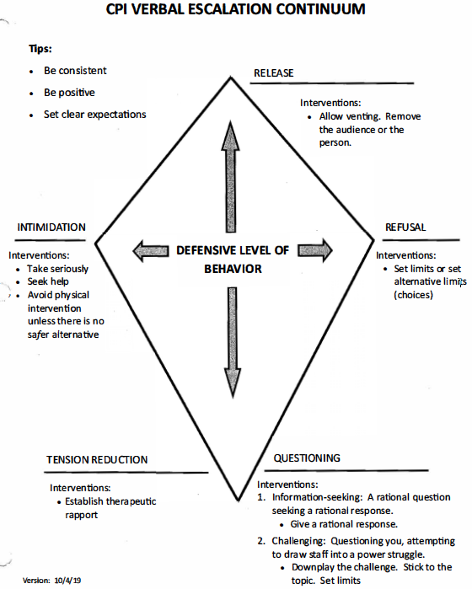

Slide 208
Positive Behavior Support Plans
53

Slide 209
Keys Steps in Development of the Plan
Develop a support team
Define the Severe Behavior
Provide extra support to the individual
Comprehensive assessment
Functional assessment
Continue to gather information
Design a Support Plan (based on the data collected) linked to the purpose or function of the behavior
Conduct regular reviews of the plan
53

Slide 210
Basic guidelines for improving and modifying plans to ensure success:
Teaching opportunities
Rewards/Reinforcement based on individual.
Celebrate plan successes
Maintain communication
Modify as needed
Provide more Training and/or Technical Assistance for DSPs
54
Notes:
Basic guidelines for improving and modifying plans to ensure success:
Teaching opportunities should happen regularly.
Rewards/Reinforcement should be based on the individual’s likes and choices. If the behavior is not improving, it could be that the reinforcement isn’t meaningful to the person, or the goal set is too high for the person to earn reinforcement.
If the plan is working…celebrate the success no matter how small the improvement may be
The team should meet regularly and have good communication. Everyone needs support during this process. The team needs to encourage everyone to have input on the plan and be able to discuss what is working and not working.
Most of the time the whole plan will not need to be changed. It might only need to be modified in some areas or new strategies may need to be added. As a DSP, you should be attending the team meetings to share your experiences with implementing the plan. *anecdotal evidence based on implementation
Provide more Training and/or Technical Assistance: As a DSP it is not enough to just “read” a support plan. You should have opportunity to ask questions, watch someone demonstrate; receive frequent reminders and frequent feedback on how you are doing. A DSP needs to have “Role Models” to assist them in carrying to the plan effectively. This true for a “new’ Direct Support Professional.

Slide 211
What is a crisis or emergency?
A situation in which an individual has a serious mental illness or developmental disability and one of the following apply:
Expected in near future to physically injure themselves or another individual either intentionally or unintentionally.
Unable to provide themselves food, clothing, or shelter or attend to basic physical activities such as eating, using the toilet, bathing, grooming, dressing or walking, and this inability may lead soon to harm to themselves or others.
Remember this is not a typical behavior for the individual!
55

Slide 212
Crisis Intervention
If they have a history of Challenging Behavior there should be a positive behavior support/treatment plan in place—follow this.
A positive behavior support (PBS) plan may sometimes include a “restrictive” component.
Train on the plan and techniques before carrying out the plan, from a qualified instructor. Document: date, length of training, type of training, specific techniques covered, and ability to perform the techniques. Review this regularly.
55

Slide 213
Crisis Intervention
Be proactive: provide an environment that supports choices, control, quality of life, and healthy relationships for the individuals who live in a residential setting.
Respond to challenging behaviors in a caring and supportive manner
“Hear” the behavior and use that information to assist the individual’s coping
Remember: you might not be effective in de-escalating a challenging behavior or avoiding a crisis.
55
Notes:
Be proactive: provide an environment that supports choices, control, quality of life, and healthy relationships for the individuals who live in a residential setting.
Effective teaching strategies and developing trust positive relationships with the individuals you work with will help you respond to challenging behavior in a caring and supportive manner. Since you have taken the time to get to know the individual you are able to help the individual to learn new coping skills for dealing with fear, frustration, and anger.
You have learned that behavior is a form of communication. A DSP must :hear” the behavior and use that information to assist the individual to cope with an uncomfortable situation or environment. Even when the DSP staff do everything that is outlined in this unit and know people well there is still a possibility that you MAY NOT be effective in de-escalating a challenging behavior or avoiding a crisis situation. Remember the Individuals that you assist are not always capable of avoiding confrontations with others. The DSP must accept this responsibility-aggressions and conflicts are often related to what DSP staff do and don’s do.

Slide 214
As new coping skills are learned more restrictive parts of the plan will decrease until eliminated.
If restrictive techniques are used often, positive support included in the plan should be reviewed and changed.
Reason an individual may display a behavior is obvious and at other times difficult.
DSP staff works together as a team, communicates what they have observed/what has been successful, shares with case manager.
Involve individual as much as possible in plan development; allow opportunities to make meaningful choices
Crisis Intervention
55

Slide 215
Be sure to review the Positive Behavior Support (PBS) handout which is used with permission from Development Enhancement, PLC.
Crisis Intervention
55

Slide 216
In an emergency/crisis:
DSP has multiple responsibilities and must act quickly to de-escalated the situation, assist the individual to call down, and ensure the safety of the individual and others who may be present.
Emphasis should be placed on using verbal and non-verbal communication (body language)
Use Confrontation Avoidance Techniques (C.A.T.) and Proactive Options to de-escalate
Your approach and ability to listen respectfully will send a message of support, care, and concern.
55
Notes:
DSP has multiple responsibilities and must act quickly to de-escalated the situation, assist the individual to call down, and ensure the safety of the individual and others who may be present.
Emphasis should be placed on using verbal and non-verbal communication (body language)
Use Confrontation Avoidance Techniques (C.A.T.) and Proactive Options to de-escalate
Your approach and ability to listen respectfully will send a message of support, care, and concern. Individuals may become upset, anxious, or agitated for a variety of reason. It could be a symptom of a mental illness; it could be as a result of a traumatic event that the individual experienced or a reaction to a medication. Investigation the cause or rigger for the agitation will occur after the DSP has successfully helped the person to calm down.
The following guidelines will help you understand the “DO’S AND DON’TS” for working with an individual who has become upset and could become violent or aggressive.

Slide 217
“Do’s” of defusing agitated and anxious people
Be aware of warning signs & intervene early.
Find out about the person.
Get the person to talk.
Check external causes.
Control your anger and anxiety.
Have a plan & provide alternatives.
Know when & how to retreat.
Take action & follow up.
Use other professions.
56

Slide 218
“Don’ts” of defusing agitated and anxious people
Put your hands unexpectedly on a person.
Challenge, dare, argue, threaten people or change the subject.
Sound like an overindulgent, angry or supportive parent.
Talk about them as if they aren’t there
Use derogatory terms
Make promises or use bribes
57

Slide 219
“Don’ts” of defusing agitated and anxious people
Leave without mutual agreement / the issue has been resolved *unless safety issue
Restrain the person.
Let pride force you into a fight.
Block a person’s attempt to escape
Sacrifice yourself for things.
Move the person
Stay in a small/congested space.
57

Slide 220
In an emergency/crisis:
Usually you will be successful in helping them calm down.
Occasionally individual may continue to display severe challenging behavior.
DSPs must work together as a team to protect bystanders.
DSPs to be trained on procedure: who to call, when to call, and emergency phone numbers.
Many agencies have emergency access to services and supports.
Community Mental Health for Central Michigan (CMHCM)and and Bay Arenac Behavioral Health (BABH) emergency/after hours access numbers listed in Appendix A.
DSP decides who to call based on their observations / risk of injury to the individual and others.
59

Slide 221
Call 911 When:
911: If violent/aggressive, with serious risk of physical injury to self or others. Unable to get other individuals to a safe place in the home.
Call law enforcement/police: if there is a weapon and individual is threatening to harm themselves or others.
DO NOT try to remove weapon.
60

Slide 222
After the crisis:
Priority #1: safety and well-being of the people living in the home.
Make sure the confrontation is over. Regained self-control? Environment normal?
Decompress (take time to relieve pressure from confrontation).
Debrief / follow-up
60

Slide 223
After the crisis:
Remember the individual is NOT attacking you although sometimes it may feel that way.
Be careful to be professional and separate personal feelings and reactions.
Treat people with respect and be a good role model.
60

Slide 224
After the crisis:
Debrief with person involved in the confrontation, if appropriate.
Document on an Incident Report: all physical injuries, unusual behaviors, and actions by DSPs to calm the individual.
Remember we all become angry sometimes and we almost always have a reason for our anger.
Individual may be reacting to trauma/trigger.
60
Notes:
Debrief with the person involved in the confrontation, if appropriate.
Document on an Incident Report: all physical injuries, unusual behaviors, and all actions by DSP staff to calm the individual must be. Documentation of agitated and aggressive behavior provides important information. Remember the DSP must be descriptive not evaluative when documenting. Write down what you see, not what you think those actions mean.
Remember we all become angry sometimes and we almost always have a reason for our anger. Sometimes there is a real and legitimate reason and other times it is a matter of perception: what we interpreter others behavior and actions. Most of us have learned how to control our anger. Many of the individuals we work with did not have the same opportunity to learn how to control their anger. The individual may be reacting to trauma they may have experienced or something in the environment of “fill in the blank” whatever the trigger and there are many it makes sense to respond in a calm and compassionate manner.

Slide 225
DEBRIEFING
How did I feel before, during & after confrontation?
What was person doing before, during & after confrontation?
What signs of agitation were observed before the confrontation?
What confrontation avoidance techniques &
proactive options were used? Result?
Did other staff assist? If “no” why?
If “yes” was communication clear? Were actions coordinated?
Were others present? Were they made safe?
If the incident happened again, what would I do?
How will this affect interactions with this individual
in the future?
61

Slide 226
In summary
DSPs have tools to help support individuals they work with.
Ability to look at challenging behavior from all angles.
Figure out what challenging behavior is communicating.
Examine individual’s quality of life.
Examine environment for improvements.
Respect individual’s choices.
Have dependable support team.
Work as united support team, being flexible with support needed.
61

Slide 227
Support those with challenging behavior by:
Getting to know the person.
Remembering all behavior is a form of communication.
Helping person with severe challenging behavior develop a positive behavior support plan.
Not assuming the worst about the person.
Relationships make all the difference.
Helping the person develop a positive identity.
Giving choices instead of requiring or demanding the person do something.
Helping the individual to have more FUN.
Establishing good relationships with your coworkers, mental health professionals, family member, guardians, doctors.
Developing a support plan for yourself and co-workers.
61

Slide 228
Remember!
Your role as a Direct Support Professional has an immediate impact everyday on the people to which you provide services.
61
Notes:
Your role as a Direct Support Professional has an immediate impact everyday on the people to which you provide services.
You will experience, over time, the incredible importance and value of relationships.
On that amazing journey you will discover that you are building a better and healthier world and community for the sake of humankind.
You may also discover that you are helping to take away the isolation in people’s lives, bringing equalities that all citizens have a right to, an offering care and compassions to those who sorely need it.
In your work as a Direct Support Professional, you given the opportunity to help instill in people a sense of value and dignity.
This leads to healthier self-confidence and self-esteem and, along with your encouragement as a role model, may inspire others to give rather than habitually take.
Finally, you are bringing hope and light to people and their communities: and you will discover that with out you’re the difference might never have been felt.

Slide 229
Recovery is Changing Everything
Developed by: Laurie VanWert, David Friday, Tina Dilley, Kim Cereske and Karen Amon
A Workgroup of the Bay Arenac Behavioral Health Recovery Committee
v.7/10/19
62

Slide 230
“Recovery is a process of change through which individuals improve their health and wellness, live a self-directed life and strive to reach their full potential.”
- Substance Abuse and Mental Health Services, SAMHSA, 2014
“Restoring or gaining a positive sense of identity apart from one’s condition.”
- Anthony, W. A. (1993). Recovery from mental illness: The guiding vision of the mental health service system in the 1990’s. Psychosocial Rehabilitation.
“Develop and further rebuild important connections with self and community.”
- Spaniol, L. (2005). The process of recovery from schizophrenia. Boston MA.
62

Slide 231
Understanding Recovery: Are we…
PART OF THE SOLUTION?
PART OF THE PROBLEM?
62

Slide 232
Setting the Stage
ITS OK TO ASK FOR HELP.
WORDS HAVE IMPACT.
HOPE, CHOICE, EMPOWE-RMENT
SPIRIT AND ATTITUDE
WHAT AND HOW WE SAY THINGS.
62

Slide 233
Gaining Fluency in Recovery Language: Power Robbing Language
You Should…
You need….
You can’t….
No one can do that…
Problem
But…
The best way is….
Your option is…
My advice to you is…
62

Slide 234
Gaining Fluency in Recovery Language: Empowering Language
Can, could
What have you considered
What are your options
What can you do
Up till now….
Challenges, situation, concern
And
What other ways might work
Some choices are
Options to possible consider are…
What has worked for you in the past?
63

Slide 235
Combating Stigma
Stigmatizing
Suffer from…
Retarded, bipolar, psycho, mental, drunks
They have a problem with…
Difficult / non-compliant
Stigma Busting
People with disabilities
They have Down Syndrome, Bipolar disorder
A small person with a mental illness
They need…
Determine what actions are trying to communicate, change is hard for everyone.
63

Slide 236
79% reported they were discriminated against by people in the community
21% reported they were discriminated against by people in the mental health system
63

Slide 237
Mental Health Practitioners
People who seek help for mental health reported feeling disrespected and discriminated against by health care workers (intentionally or unintentionally).
Attitudes of mental health practitioners important for good treatment outcomes and quality of life.
In role as educators and members of their communities, professionals’ view shape opinions of future practitioners and influential community members.
63

Slide 238
Empowering Interactions
Be welcoming, friendly and non-judgmental.
Be fully present and a good listener. Reflect what you heard.
Resist fixing the person.
Validate and reinforce their abilities and strengths. Focus on what’s strong. Not what’s wrong.
Ask open end questions.
Acknowledge and affirm efforts, progress and achievements.
Remind them that they are their own experts.
Promote self-advocacy/support them taking the lead. Not doing for them and taking their power away.
Roll with resistance- this a normal response that everyone has related to change.
Meet people where they are at.
Constantly evaluate your language, attitude and self care.
63

Slide 239
Policy: Provide Recovery Based Services
Guiding principle and operational framework for system of care.
Achievable for everyone.
Inclusive of all individuals (children and adults) with substance use, severe and persistent mental illness, intellectual and developmental disabilities and co-occurring conditions.
64

Slide 240
Four Major Dimensions
HEALTH
HOME
PURPOSE
COMMUNITY
64

Slide 241
Ten Guiding Principles
Emerges from hope
Person- driven
Occurs via many pathways
Is holistic
Is supported by peers and allies
Is supported through relationships and social networks
Is culturally based and influenced
Is supported by addressing trauma
Involves individuals, family, and community strengths and responsibilities
Is based on respect
64

Slide 242
To Facilitate Recovery it takes all of US!
Recovery is the individual’s responsibility.
Assisting people in their recovery is the responsibility of all BABHA staff and all other Staff.
All agency staff will develop welcoming, positive and caring relationship, accepting the individual as a unique and valuable person.
Helping the person develop strength-based goals that focus on gaining to regaining critical life functions.
65

Slide 243
Be Vocal by Demi Lovato
65

Slide 244
65

